Slide 1
Where Should a Cafe be opened in the Sydney CBD and Surrounds?
Capstone Project for IBM Data Science
William Li, 19/04/21

Slide 2
Background
- Sydney, Australia is a global city
- Lots of potential to open a cafe
- Can tap into white collar workers or tourists

Slide 3
Business Problem
- Strong competition for customers
- Strong ‘coffee culture’ around Sydney
- Cafe owners and potential owners could have interest in this problem
- Location is important to tap into the maximum number of customers

Slide 4
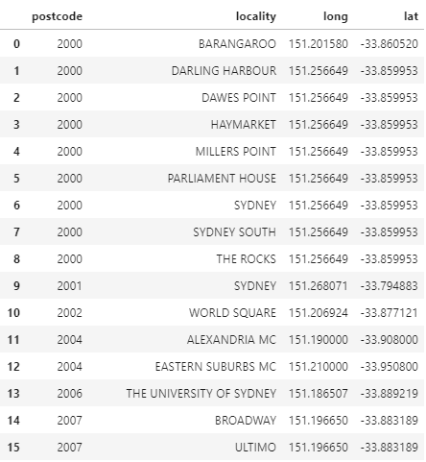
Data
- One source: https://www.matthewproctor.com/australian_postcodes
- 3200 postcodes in Australia narrowed down to 23 around Sydney CBD
- Foursquare API uses latitude and longitude from the postcode file to find the venues around the postcodes

Slide 5
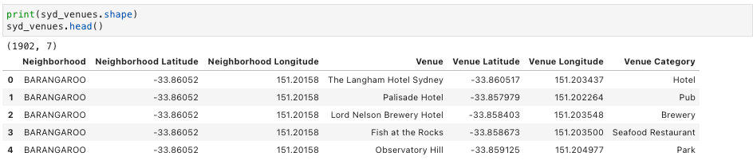
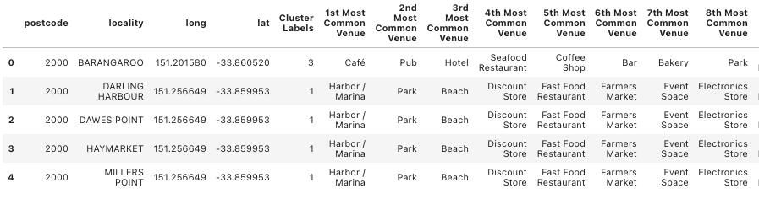
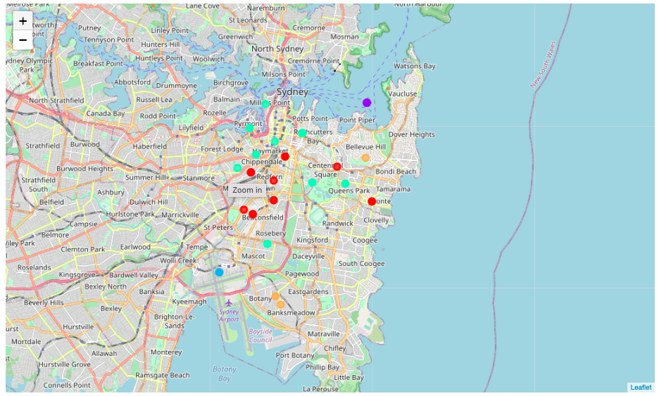
Methodology
- 1902 venues within 750 metres of each geographical coordinates
- K-means Clustering
- 5 clusters

Slide 6
Results
- Cluster 1: Cafes
- Cluster 2: Harbour/Marina
- Cluster 3: Airport/Lounge
- Cluster 4: Mixture of Cafe and Restaurant
- Cluster 5: Mixture of Venues

Slide 7
Discussion
- Cluster 1: Cafes - most number of localities; cafes everywhere here
- Cluster 2: Harbour/Marina - good for ferry commuters
- Cluster 3: Airport/Lounge - good for air travellers
- Cluster 4: Mixture of Cafe and Restaurant - most relevant localities
- Cluster 5: Mixture of Venues - good for blue collar workers
This is purely geographical analysis only. Other factors such as rent, building integrity and opening hours not part of this analysis.

Slide 8
Conclusion
Cluster 1 is personally recommended when considering 2nd-most common venues etc.

